Slide 1
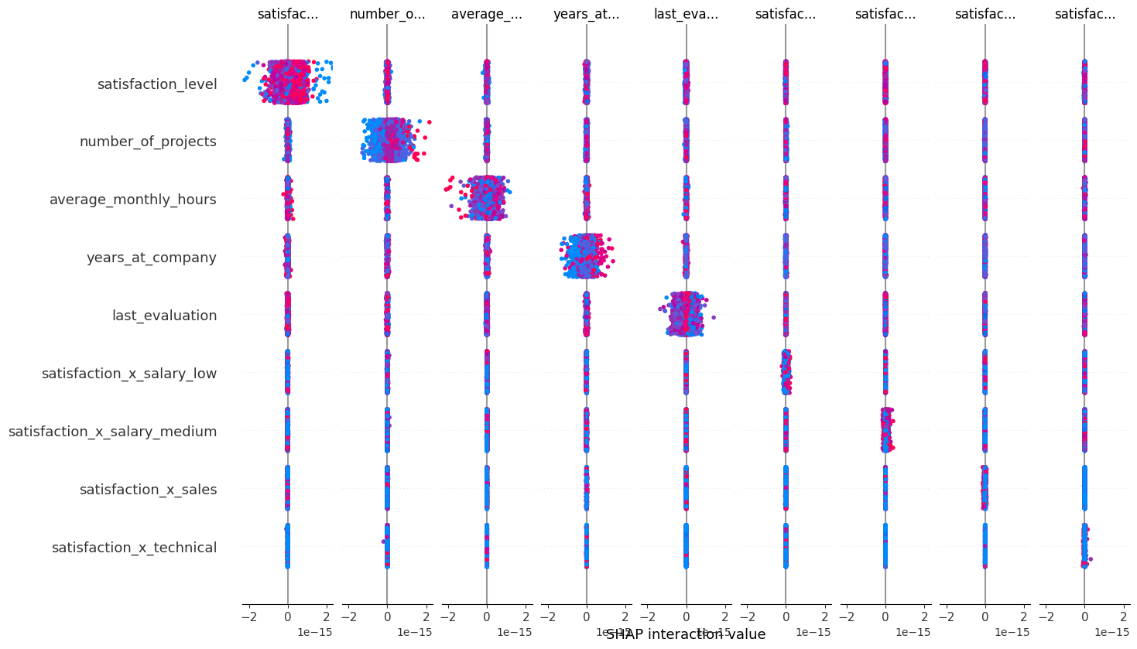
Employee Turnover Prediction for Salifort Motors
Predicting Employee Attrition Using Machine Learning
This project focuses on predicting employee turnover at Salifort Motors using machine learning techniques. The primary goal is to identify key factors influencing employee attrition and develop a model that accurately predicts whether an employee will stay or leave the company. This prediction enables the company to proactively address employee satisfaction and retention strategies.
Employee turnover is a significant issue for Salifort Motors, leading to increased recruitment and training costs, loss of organizational knowledge, and reduced productivity. Understanding the drivers of turnover and predicting at-risk employees can help the company implement effective retention strategies and improve overall employee satisfaction.
A Random Forest model was developed to predict employee turnover using various features, including satisfaction level, number of projects, years at the company, average monthly hours, and last evaluation score. The model achieved high accuracy, precision, recall, and F1 score, indicating its robustness in predicting employee turnover. The model's performance was validated using multiple metrics, and it demonstrated strong predictive power.
The dataset used for this project included features such as satisfaction level, number of projects, years at the company, average monthly hours, last evaluation score, and interaction terms with salary levels and departments.
Model Validation Results:
Tuned Accuracy: 0.9812
Tuned Precision: 0.9811
Tuned Recall: 0.9052
Tuned F1 Score: 0.9416
Tuned AUC: 0.9748
Drift Detection Result: 0 (No significant drift detected)
The SHAP interaction plot illustrates the interaction effects between the top features influencing employee turnover.
SHAP interaction plot.
Implementation: Deploy the model in a production environment to start monitoring and predicting employee turnover in real-time. Monitoring and Updating: Continuously monitor the model's performance and update it with new data to maintain its accuracy and relevance. Employee Interventions: Use the predictions to identify at-risk employees and implement targeted interventions to improve their satisfaction and retention. Further Research: Explore additional data sources and advanced algorithms to further enhance the model's predictive capabilities. Ethical Considerations: Ensure the model's use is ethical, transparent, and fair, avoiding any potential biases in predictions and interventions.

